Slide 1
Cluster quality measure
The Mahalanobis distance of spike i form the center of the cluster c is defined by the formula [2],
where is the feature vector for spike i, is the mean of the values of the spikes in cluster c;
is the covariance matrix of the spikes in cluster c .
where is the set of spikes which are not members of the cluster and is the cumulative
dustribution function of the distribution with freedom . A low value of the L indicates that the cluster have a good ‘moat’ and is well separated from other spikes.
where is the number of spikes in cluster c. Using a criterion based on rather than allows
Clusters with larger numbers of spike to tolerate more contamination.
[2] N. Schmitzer, J. Jackson, D.Henze , K.Harris and A. D. Redish . Quantitative measures of cluster quality for use in extracellular recordings. Neuroscience, 131: 1-11,2005.

Slide 2
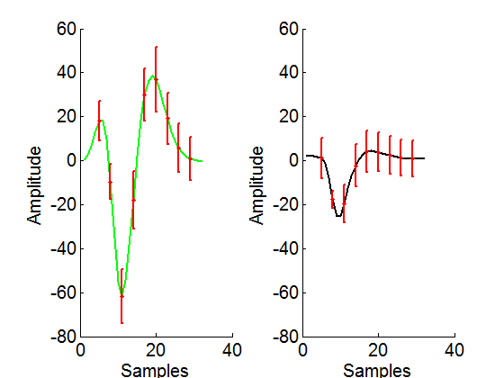
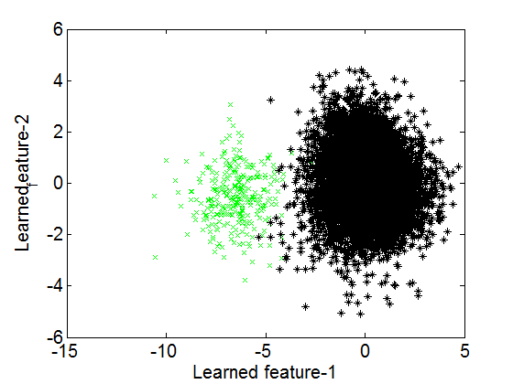
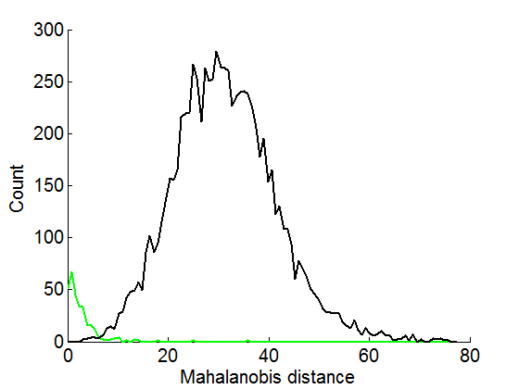
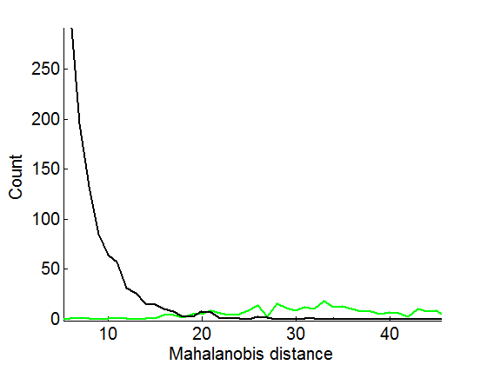
Experiment on Pitts dataset
Cluster-1
Cluster-2
Average mean and standard deviation for each cluster
2-D plot for the first two learned features
Mahalanobis distance at the center of cluster 1
Mahalanobis distance at the center of cluster 2
Dataset from file TRIAL38_CHAN46_TANKSORT_WAVEFORMS (channel-6)

